Slide 1
GRAPHICS CLASS

Slide 2
The Graphics class
-------------------------
This class contains methods for drawing
strings , lines,rectangles,and other shapes
defined in the graphics class.
Drawing characters,bytes and strings
100,101,103,124,97,87 - Bytes
"graphics" - Strings
void drawBytes(byte[] data,int offset,
int length,int x,int y)
data -> the data to be drawn
offset-> the start offset in the data
length-> the no.of bytes that are drawn
x-> x co-ordinate
y-> y co-ordinate
void drawChars(char[] data,int offset,int length,int x,int y)
abstract void drawString(String str,int x,int y

Slide 3
import java.applet.*;
import java.awt.*;
public class drawCBS extends Applet {
byte b[]={100,114,97,119,66,121,116,101,115};
char c[]={'d','r','a','w','c','h','a','r','s'};
String s="drawString example";
Font f;
public void init() {
f = new Font("TimesRoman",Font.BOLD,30);
}
public void paint(Graphics g)
{
g.setFont(f);
g.setColor(Color.red);
g.drawBytes(b,0,9,100,30);
g.drawChars(c,2,3,100,60);
g.drawString(s,100,90);
}
}
//<applet code="drawCBS.class" width=500 height=500></applet>

Slide 4
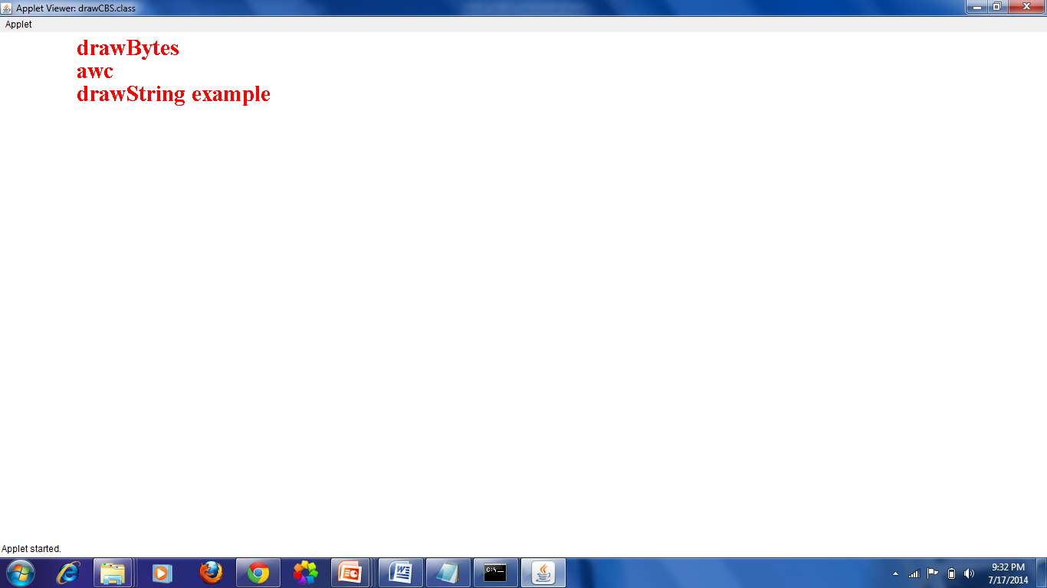

Slide 5
Draw Lines,Rectangles and Ovals
---------------------------------------------
drawLine(int x1,int y1,int x2,int y2)
- x1,y1 starting point x2,y2 ending point
drawRect(int x1,int y1,int width,int height)
fillRect(int x1,int y1,int width,int height)
x1,y1 starting point
width - width of the rectangle
height - height of the rectangle
drawRoundRect(int x1,int y1,int width,int height,
int angle1,int angle2)
fillRoundRect(int x1,int y1,int width,int height,
int angle1,int angle2)
x1,y1 - starting point
width - width of the rectangle
height - height of the rectangle
width1 - width1 of the angle corners
height1 - height1 of the angle corners

Slide 6
drawPolygon(int xs,int ys,int pts)
fillPolygon(int xs,int ys,int pts)
xs - an array of integers representing
x co_ordinates
ys - an array of integers representing
y co_ordinates
pts an integer representing the total
no of points
drawOval(int x1,int y1,int widht,int height)
fillOval(int x1,int y1,int width,int height)
x1,y1 - starting point of the oval
width,height - width and height of the oval
drawArc(int x1,int y1,int width,int height,angle1
,angle2)
fillArc(int x1,int y1,int width,int height,angle1
,angle2)
angle1 - degree value at which the arc starts
angle2 - degree value at which the arc ends

Slide 7
import java.awt.*;
import java.applet.*;
public class drawShapes extends Applet {
// this is for drawPolygon
int xs[]={40,49,60,70,57,40};
int ys[]={260,310,315,280,260,270};
//this is for fillpolygon
int xss[]={140,150,180,200,170,150,140};
int yss[]={260,310,315,280,260,270,265};
public void paint(Graphics g) {
g.drawString("Some of the drawing objects",150,400);
g.drawLine(40,30,200,30);
g.drawRect(40,60,70,40);
g.fillRect(140,60,70,40);
g.drawRoundRect(240,60,70,40,10,20);
g.fillRoundRect(40,120,70,40,10,20);
g.drawOval(240,120,70,40);
g.fillOval(40,180,70,40);
g.drawArc(140,180,70,40,0,180);
g.fillArc(240,180,70,40,0,-180);
g.drawPolygon(xs,ys,6);
g.fillPolygon(xss,yss,7);
}
}
//<applet code="drawShapes.class" width=500 height=500></applet>

Slide 8
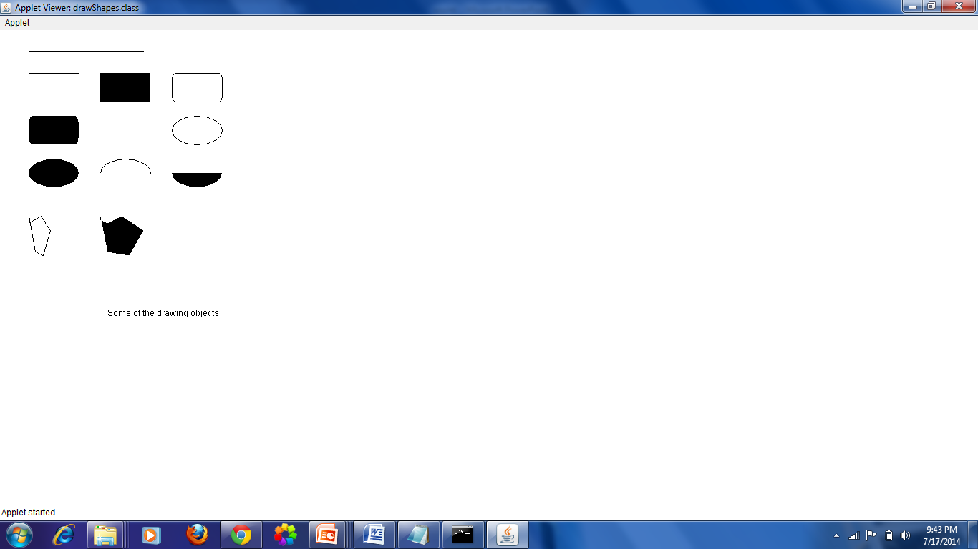

Slide 9
Applet life cycle
init () – first method to be called
gets called as soon as the applet started
Called only once during run time of applet
start() - This method is executed after the init()
Called to restart an applet
Called Each time an applet HTML doc is displayed.
paint(Graphics g) - draws the object in the applet
Redraw
Graphics content

Slide 10
Continue…
stop() - is used to halt the running of an applet.
When it goes to the next page
Restart using start()
destroy() - is used to free the memory occupied by the variables and objects initialized in the applet
Applet gets removed from memory
repaint() - is used in case an applet is to be repainted.
The repaint() calls the update() method, to clear the screen of any existing context.
The update() method in turn calls the paint() method that then redraws the context of the current frame.

Slide 11
Font
family name – general name- courier
logical name – category of font- monospaced
face name – specific font – courier italic

Slide 12
Fonts Class
Text can be written inside an applet using different fonts. The font class of Java offers a wide variety of fonts like TimesRoman,Courier,Helvetica, Futura,Platino etc.,
Font Styles :- BOLD,PLAIN,ITALIC
Constants Description
--------------- ------------------
static int BOLD Font.BOLD
static int PLAIN Font.PLAIN
static int ITALIC Font.ITALIC

Slide 13
Constructor
Font(String name,int style,int size)
Creates a new font from the specified
name, style and size

Slide 14
Methods | Description
abstract void setFont(f) | set this graphics contexts font to the specified font
String getStyle() | returns a string value that indicating the current font style
int getSize() | returns an integer value that indicating the current font size
String getFamily() | Returns the font family name as a string
boolean isPlain() | Returns true if the font is plain
boolean isBold() | Returns true if the font is bold
boolean isItalic() | Returns true if the font is italic

Slide 15
import java.applet.*;
import java.awt.*;
public class fonts extends Applet {
Font f,f1,f2;
int style,size;
String s,s1;
public void init() {
f=new Font("Helvetica",Font.BOLD,20);
f1=new Font("TimesRoman",Font.BOLD,10);
f2=new Font("Courier",Font.ITALIC,20);
}
public void paint(Graphics g) {
g.setFont(f);
g.drawString("Font name is : Helvetica",30,30);
g.setFont(f1);
g.drawString("Font name is : TimesRoman",30,80);
g.setFont(f2);
g.drawString("Font name is : Courier",30,130);
style=f.getStyle();
if(style==Font.PLAIN)
s="PLAIN";
else if(style==Font.BOLD)
s="BOLD";
else if(style==Font.ITALIC)
s="ITALIC";
else
s="BOLD AND ITALIC";
size=f2.getSize();
s1=f2.getName();
s1+= " size is " + size + " style is " + s;
g.drawString(s1,30,180);
g.drawString("Font family is : " +f2.getFamily(),30,250);
}
}
//<applet code="fonts" width=500 height=500></applet>

Slide 16
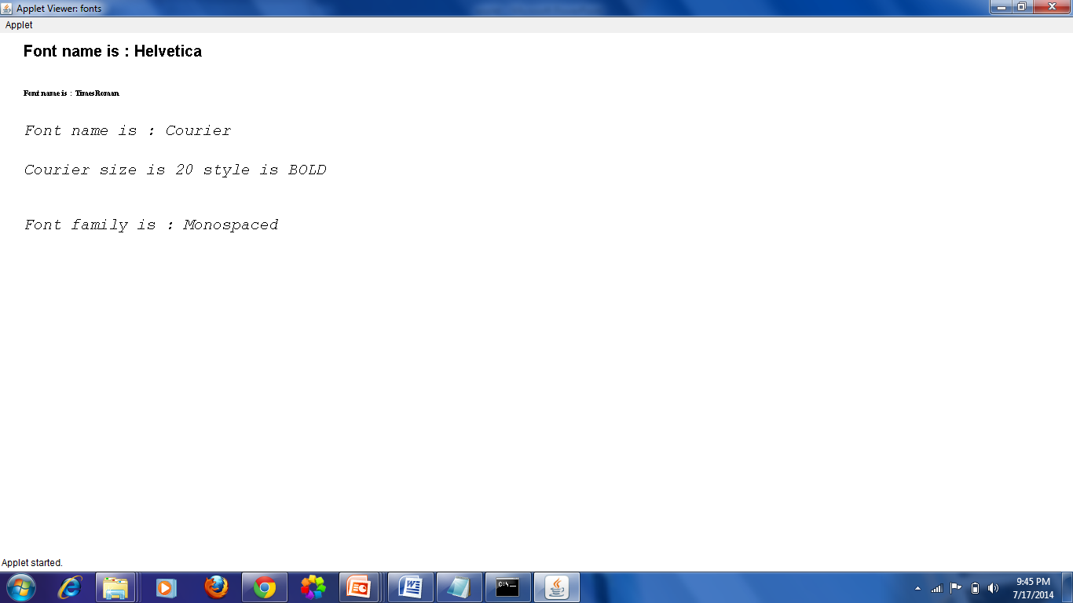

Slide 17
Color Class
Colors are represented as combination of red,blue and green. Each component can have a no between 0 to 255, 0,0,0 is black and 255,255,255 white
Color Name RGB value
--------------- --------------
Color.gray 128,128,128
Color.green 0,255,0
Color.yellow 255,255,0
Color.pink 255,175,175
Color.red 255,0,0
Color.blue 0,0,255
Color.magenta 255,0,255
Color.cyan 0,255,255

Slide 18
Methods | Description
setColor() | - set color to an object
setBackground() | - sets background color of an applet
setForeground() - used to change the color of the whole applet after it has been drawn. | - used to change the color of the whole applet after it has been drawn.
getBackground()
getForeground()

Slide 19
import java.awt.*;
import java.applet.*;
public class ColorApplet extends Applet {
Font f,f1,f2;
public void init()
{
f=new Font("TimesRoman",Font.BOLD,20);
f1=new Font("Courier",Font.ITALIC,20);
f2=new Font("Helvetica",Font.PLAIN,20);
}
public void paint(Graphics g) {
setBackground(Color.cyan);
g.setColor(Color.green);
g.setFont(f);
g.drawString("Be Happy. Be Hopeful",30,30);
g.setColor(Color.blue);
g.setFont(f1);
g.drawString("Be Happy.Be Hopeful",30,70);
g.setColor(Color.pink);
g.setFont(f2);
g.drawString("Be Happy.Be Hopeful",30,110);
}
}
//<applet code="ColorApplet" width=500 height=500></applet>

Slide 20
